Slide 1
Understanding construction of a circle
Constructions

Slide 2
how to use Oak lessons

Slide 3
I can recognise a circle as a collection of points equidistant from a fixed point.

Slide 4
The circumference of a circle is the perimeter of the circle.
An arc is part of a curve. An arc of a circle is part of the circle’s circumference.
Points A and B are equidistant from a third point C if the distance AC is equal to the distance BC.
A fixed point is a point that does not change or move.

Slide 5

Understanding construction of a circle
Properties of a circle
Properties of an arc of a circle

Slide 6
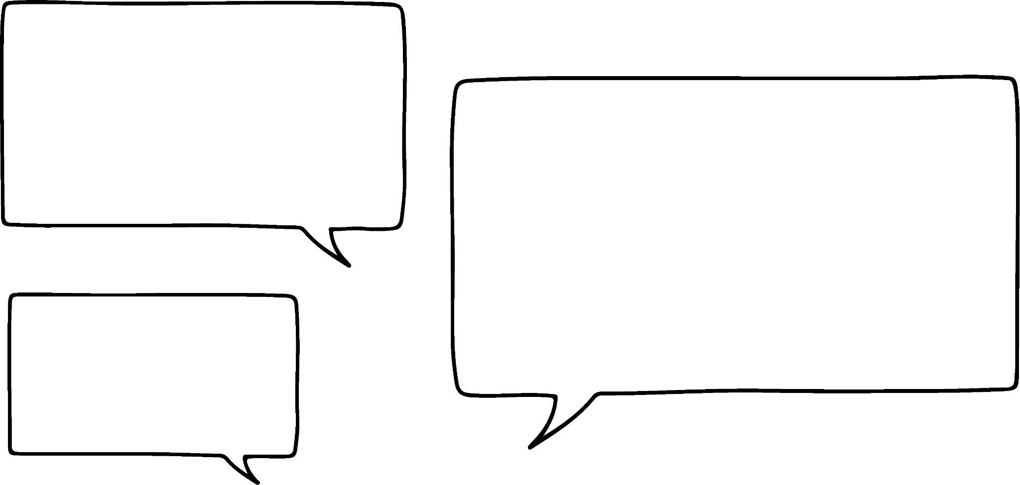
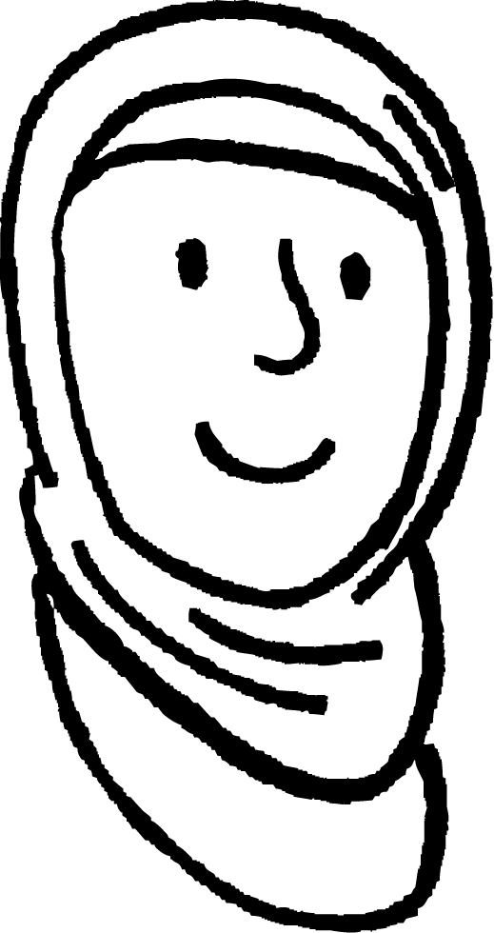
Properties of a circle
Take a piece of plain paper and mark a cross somewhere near the middle of the page.
Using a ruler, mark a point that is exactly 5 cm away from the cross.
Mark some more points that are exactly 5 cm away from the cross.
The points would look like a circle.
5 cm
The points follow the path of a circle.
5 cm
5 cm
5 cm
5 cm
What do you notice?
Aisha
What would it look like if we plotted 1000 points?

Slide 7
Properties of a circle
When we plot multiple points that are all equidistant from a single point, they follow the path of a circle or an arc of a circle.
A circle is a shape such that every point is equidistant to its centre.
5 cm
5 cm
5 cm

Slide 8
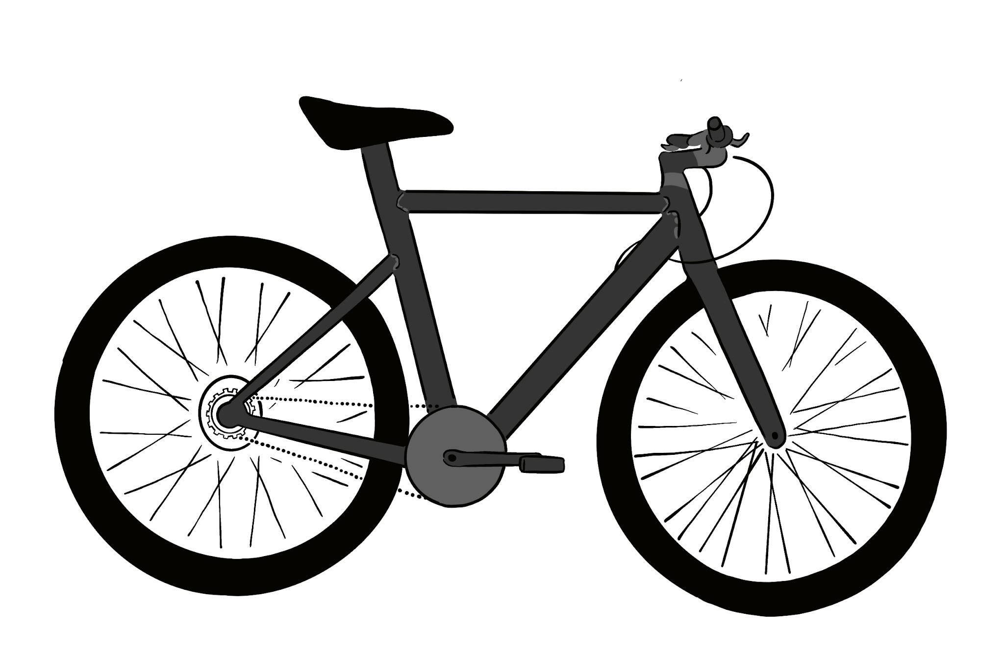
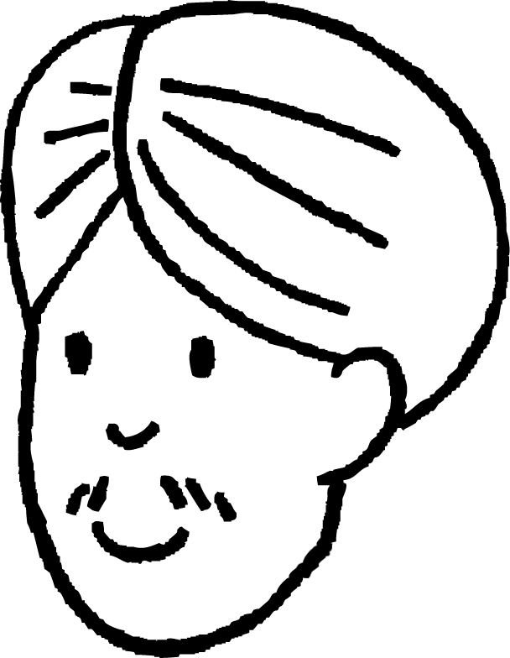
Properties of a circle
For example, the side view of a wheel is a circle.
Why is it important for every point on the edge of a wheel to be equidistant to its centre?
Imagine what it would be like if every point wasn’t equidistant to the centre.
Each radius is 13 inches.
Andeep
Can you think of anything else that forms or moves in a circle?

Slide 9
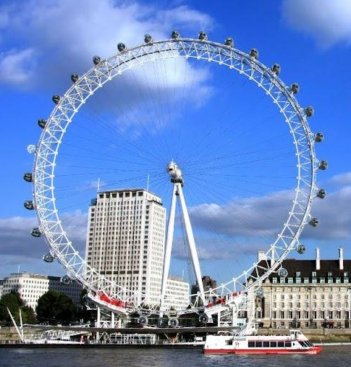

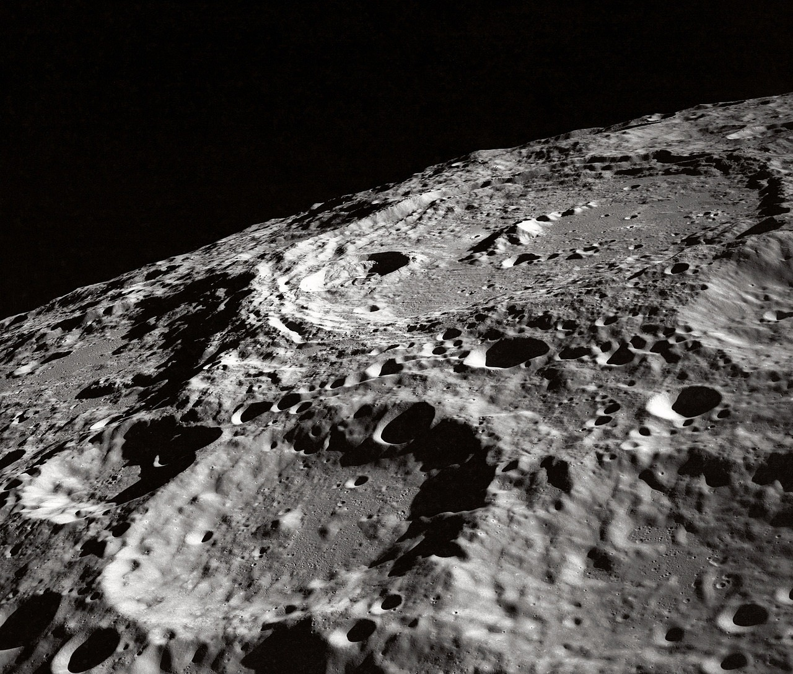
Properties of a circle
Each pod is equidistant from the fixed point at the centre of the wheel.
The tip of each hand remains equidistant from the fixed point at the centre of the clock.
The edges of an impact crater are approximately equidistant from its centre.

Slide 10


Properties of a circle
In which circle is the centre plotted in the correct position?
Let’s investigate.
Method 1: look at each diagram
The point in the left diagram looks more like it is in the centre.
How could we be more certain?

Slide 11
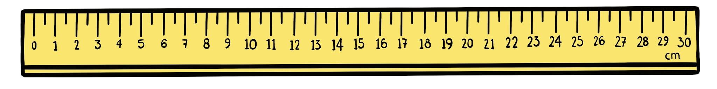
Properties of a circle
In which circle is the centre plotted in the correct position?
Let’s investigate.
Method 2: using a ruler
radii:
radii:
5 cm
5.3 cm
5 cm
4.6 cm
5 cm
5.5 cm
5 cm
4.5 cm
How could we be more certain?

Slide 12
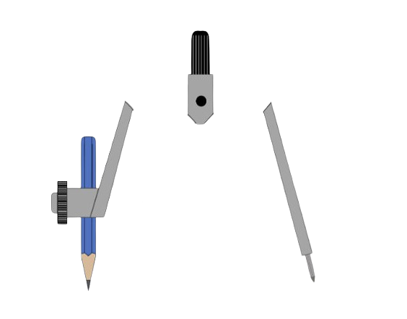
Properties of a circle
In which circle is the centre plotted in the correct position?
Let’s investigate.
Method 3: using a pair of compasses

Slide 13
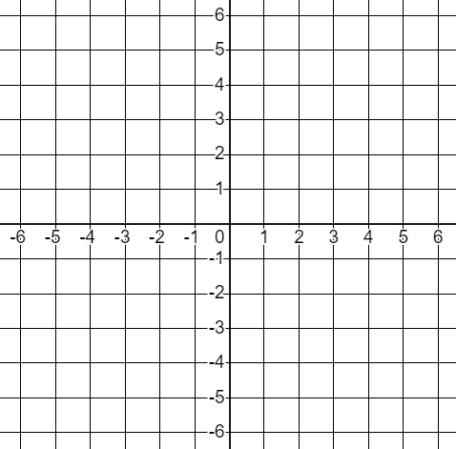
Properties of a circle
Find the coordinates of 12 points which are 5 units away from the origin.
(5, 0)
(4, 3)
(-4, -3)
(0, 5)
(3, 4)
(-3, -4)
5
(-5, 0)
(-3, 4)
(3, -4)
5
5
(0, -5)
(-4, 3)
(4, -3)
5

Slide 14
Properties of a circle
equidistant
Every point on a circle is from its centre.

Slide 15
Properties of a circle
AB = AC
A
B
C
You can not tell without measuring with a ruler.
Every point on a circle is equidistant from its centre.

Slide 16
Properties of a circle
1) a) Mark 8 points that are exactly 7 cm away from the cross. b) Draw a circle with radius 7 cm and with the centre at the cross. c) What do you notice about the points from part (a) and the circle from part (b)?

Slide 17
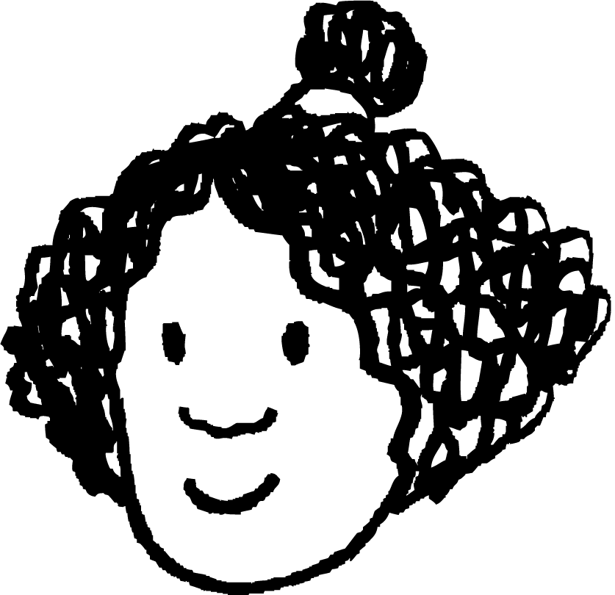
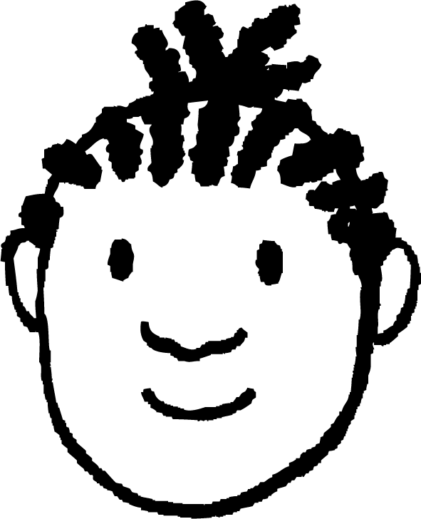






Properties of a circle
2) Aisha marks a cross on a piece of paper and marks a point exactly 5 units away from it.
She asks everyone else to mark a point 5 units away from the cross.
a) How could you use a pair of compasses to check whether everyone’s point is the correct distance away from the cross?
b) Whose point is too close to the cross?
c) Whose point is too far from the cross?
Izzy
Andeep
Jacob
Alex
Aisha
Jun
Lucas
Laura
Sofia
Sam

Slide 18
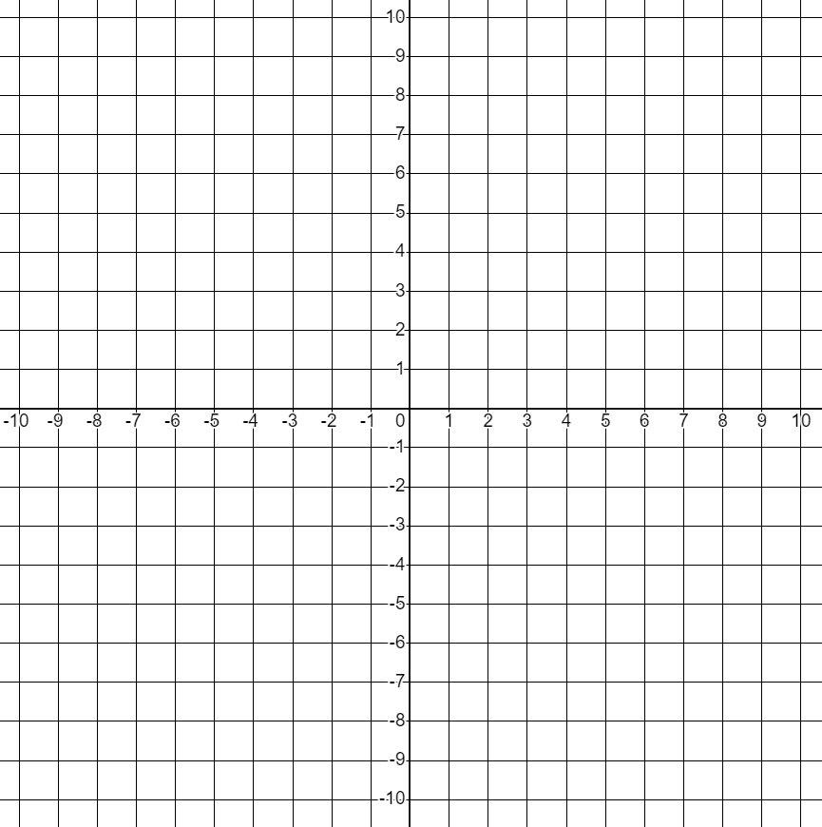
Properties of a circle
3) Find the coordinates of 12 points which are exactly 10 units from the origin.

Slide 19
Properties of a circle
1) a) Mark 8 points that are exactly 7 cm away from the cross. b) Draw a circle with radius 7 cm and with the centre at the cross. c) What do you notice about the points from part (a) and the circle from part (b)?
E.g.
All of the points lie on the circle.

Slide 20
Properties of a circle
2) Aisha marks a cross on a piece of paper and marks a point exactly 5 units away from it.
She asks everyone else to mark a point 5 units away from the cross.
a) How could you use a pair of compasses to check whether everyone’s point is the correct distance away from the cross?
b) Whose point is too close to the cross?
c) Whose point is too far from the cross?
Izzy
Andeep
Jacob
Alex
Aisha
Draw a circle with the cross at the centre and Aisha’s point on the circle.
Jun
Jacob
Lucas
Laura
Sofia
Sofia
Sam

Slide 21
Properties of a circle
3) Find the coordinates of 12 points which are exactly 10 units from the origin.
(10, 0)
(8, 6)
(-8, -6)
(0, 10)
(6, 8)
(-6, -8)
(-10, 0)
(-6, 8)
(6, -8)
(0, -10)
(-8, 6)
(8, -6)
These are the only coordinates with integer values. There are more coordinates with decimal values.

Slide 22
Understanding construction of a circle
Properties of a circle
Properties of an arc of a circle

Slide 23
Properties of an arc of a circle
An arc of a circle is part of the circle’s circumference.
Every point on the arc of a circle is equidistant to its centre.
5 cm
5 cm
5 cm
5 cm
5 cm
5 cm

Slide 24
Properties of an arc of a circle
For example, a wrecking ball swings in an arc of a circle.
While the chain is taut, the ball is always the same distance away from the fixed point at tip of the crane.
Laura
Can you think of anything else that forms or moves in an arc?

Slide 25
Properties of an arc of a circle
The curve below is an arc of a circle. Which point would be the centre of the circle? How could we find out?
A
Point C is the centre.
B
C

Slide 26
Properties of an arc of a circle
equidistant
Every point on the arc of a circle is from the centre of its complete circle.

Slide 27

Properties of an arc of a circle
A see-saw tilts around a fixed point to raise and lower the seats at each end.
seat
Which image shows the path that the seats moves?
a
b
c

Slide 28
Properties of an arc of a circle
Which arc will the pair of compasses draw?
A
B
C
D

Slide 29
Properties of an arc of a circle
1) W, X, Y and Z are arcs from four circles. A, B, C and D are four possible centres for these circles. Match the arcs to their centres.
W
Z
X
A
D
B
C
Y

Slide 30
Properties of an arc of a circle
1) W, X, Y and Z are arcs from four circles. A, B, C and D are four possible centres for these circles. Match the arcs to their centres.
W
A and Y
B and X
C and W
D and Z
Z
X
A
D
B
C
Y

Slide 31
Understanding construction of a circle
The collection of points an equal distance from a given point form a circle.
A pair of compasses can be used to draw a circle with a particular radius.
The centre of a circle is the point that is the same distance from every point on the circle.
Drawing with a pair of compasses becomes easier over time with practice.

Slide 32

© Oak National Academy 2023.
Produced in partnership with Mathematics in Education and Industry.
Licensed on the Open Government Licence v3.0, except where otherwise stated. See Oak terms and conditions.

